Slide 1
Project 2 - Unity VR “Rogue-Like”
Andrew Phipps

Slide 2
Overview
I made a simple “rogue-like,” where you navigate through procedural dungeons to find the next level. There are skeleton AI within the dungeon that will attack you as you try and proceed. To assist you there is randomly generated loot in the form of potions and weapons.
The goal of the game is to see how deep you can make it, with the game over screen and main menu displaying what floor you made it to in your current play session.

Slide 3
Implementation
There are 4 main parts to my implementation:
Player Controls & Interaction
Grabbable Objects
Enemy AI
Dungeon Generation

Slide 4
Player Movement
Both the player controls and interaction system is similar to what we did in class, however the are a few difference.
The two main parts that make up the player controls are the Hand script and the Player script. The Player script has a reference to two hands, which are used to detect input from the OVR.Input class.
The input is then used to “drive” the player’s rigidbody (this rigidbody is also used to detect collisions with the environment).

Slide 5
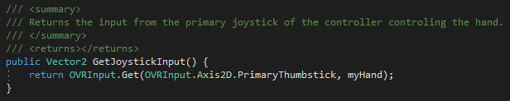
Input

Slide 6
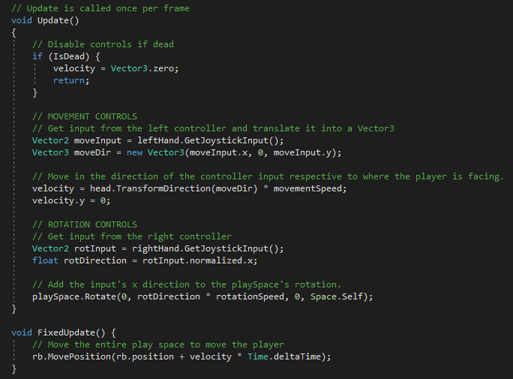
Player Movement

Slide 7
Player Interaction & Grabbable Objects
As mentioned before the player interaction is similar to that from class with a few tweaks. Like in class we use the OnTriggerStay() method to detect if our hand close to a grabbable object. If the player then pulls the trigger the object will be picked up.
In addition to this method I also used raycasts to allow the player to pick up objects from afar. This raycast is shot from the player’s hand in a straight line and determines is a grabbable what hit.
It’s also in this way that the player is able to interact with world space UI. Things such as buttons have colliders attached to detect if the player is attempting to interact with them.

Slide 8
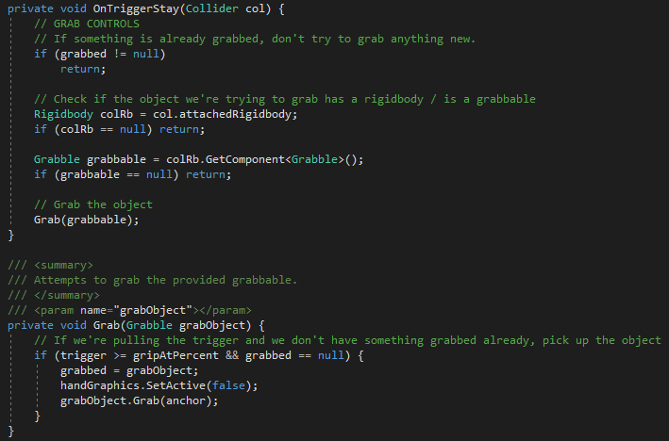
Grabbing

Slide 9
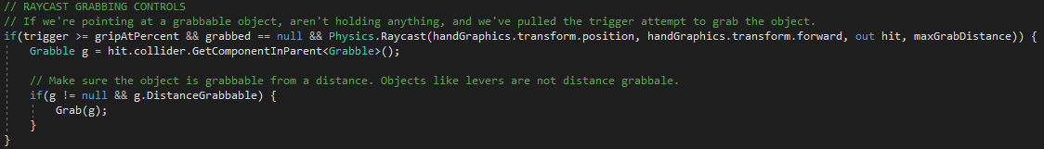
Raycast Grabbing

Slide 10
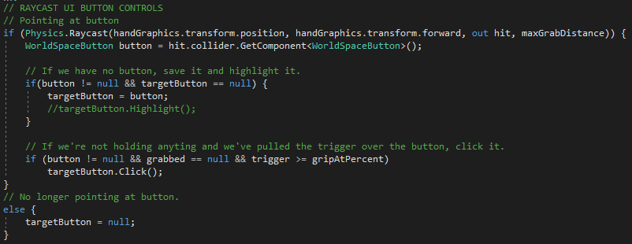
Raycast UI Interaction

Slide 11
Special Grabbable Objects
Certain grabbable objects in my game have special properties. The main three are weapons, destructibles, and consumables.
Weapons simply apply damage when their trigger hits an object that has a IDamageable component attached. IDamageable is an interface implemented by Destructible objects and Entity objects (enemies and the player). This interface has classes implement the TakeDamage and TakeHit methods.
Destructibles fracture when taking damage by spawning a fractured object made in blender. Currently the only destructible
Finally, the consumables allow the player to “consume” the grabbable to gain certain effects. For example, the potion in the game is a consumable that heals the player. This is done using the Consumable class and the ConsumeableEffect scriptable object that specifies the effect.

Slide 12
Enemy AI
For the enemy AI I used Unity’s NavMeshAgent class to navigate around the dungeon. Each enemy has a trigger attached to detect if the Player has gotten close enough for them to start chasing them and attacking.
The fighting AI is broken down into three coroutines, which has the enemy chase the player to move within attack range, and attack once within range. The Fight coroutine acts as a controller, deciding whether to chase or attack and the Attack and Chase coroutines have the enemy chase or attack.
These three coroutines and the trigger would control the skeleton character I made in blender’s animations and play the “aggro” and attack sounds.

Slide 13
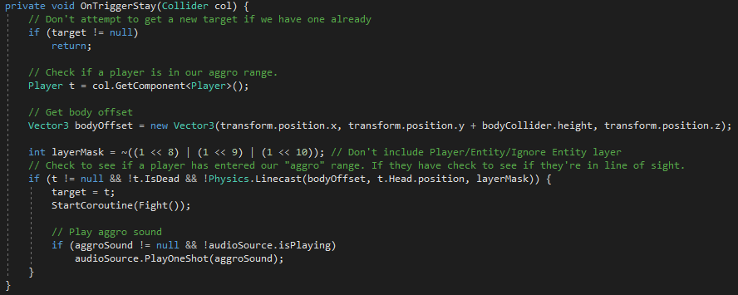
Enemy “Aggro”

Slide 14
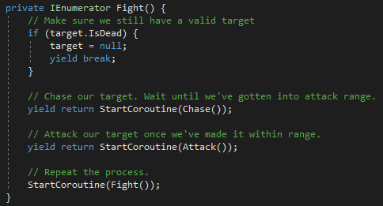
Enemy Fight

Slide 15
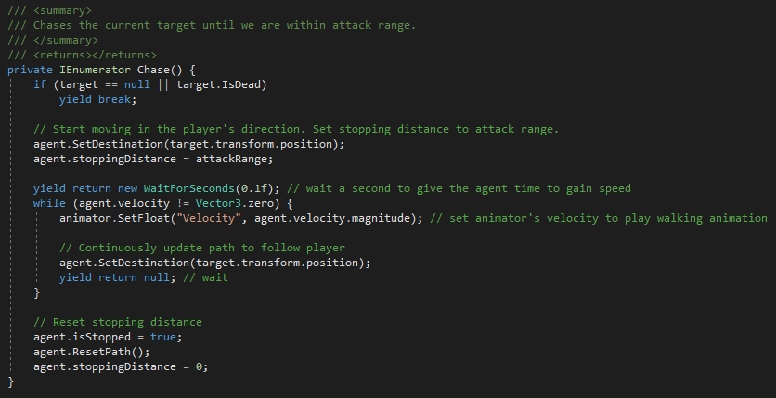
Enemy Chase

Slide 16
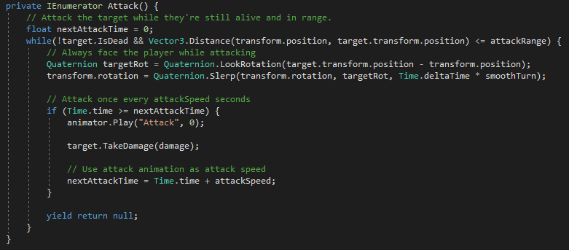
Enemy Attack

Slide 17
Dungeon Generation
The dungeon generation is done on scene load by the Dungeon Generation class. It uses the helper class DungeonFloorData to determine which types of rooms should be spawned. The generation is done in two steps: GenerateFloor and BuildRooms.
The GenerateFloor() coroutine generates the layout of the dungeon using a 2D array. The way it does this is by starting with a room in the center and then branching out into adjacent rows/cols.
The BuildRooms() coroutine is called by the GenerateFloor() coroutine after it’s done building the map. This method simply instantiates the room prefabs I made in blender and toggles their doors based on adjacent rooms. These prefabs are also in the Dungeon Floor Data class.

Slide 18
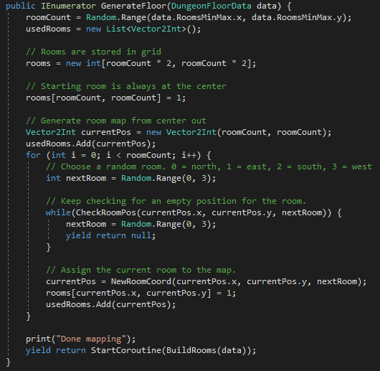
Dungeon Floor Generation

Slide 19
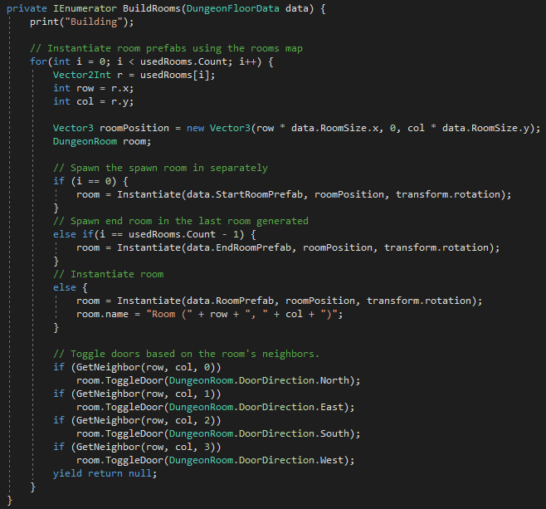
Dungeon Room Building

Slide 20
Dungeon Generation - Navigation
Initially when the rooms where instantiated in they would build their own NavMeshes at runtime within the DungeonRoom class. This utilized the UnityEditor namespace to use the NavMeshBuilder.BuildNavMesh() function. Unfortunately, the UnityEditor namespace cannot be used in game builds and as such this broke my navigation for the enemy AI.
Fortunately, Unity has a github package that allows you to generate NavMeshes at runtime and also bake them into prefabs. I’m not entirely sure why this isn’t included in Unity by default (as it’s very useful when dealing with AI), but adding this package to my game was simple enough.

